Slide 1
Architecture Design
Instructor: Mehroze Khan

Slide 2
Design Methodology
We have an
abstract description of a solution to our customer’s problem
a software architectural design
a plan for decomposing the design into software units and allocating the system’s functional requirements to them
No distinct boundary between the end of the architecture-design phase and the start of the module-design phase
No comparable design recipes for progressing from a software unit’s specification to its modular design
The process taken towards a final solution is not as important as the documentation produced
Design decisions are periodically revisited and revised
Refactoring
to simplify complicated solutions or to optimize the design

Slide 3
Design Documentation
The details of the system architecture is documented in Software Architecture Document (SAD)
SAD serves as a bridge between the requirements and the design
Program (or module) design acts as a bridge from architecture design to code
Many ways to document the design
Design by contract: a particular approach that uses the documentation not only to capture the design but also to encourage interaction among developers

Slide 4
Design by Contract
In design by contract, each module has an interface specification that precisely describes what the module is supposed to do
Meyer (1997) suggests that design by contract helps ensure that modules interoperate correctly
This specification, called a contract, governs how the module is to interact with other modules and systems
Such specification cannot guarantee a module’s correctness, but it forms a clear and consistent basis for testing and verification
The contract covers mutual obligations (the preconditions), benefits (the postconditions), and consistency constraints (called invariants)
Together, these contract properties are called assertions

Slide 5
Design by Contract
As the module provider, we uphold our end of the contract as long as
Our module provides (at the least) all of the postconditions, protocols, and quality attributes that are advertised in the interface specification
Our code requires from its environment no more than what is stated in the interface’s preconditions and protocols
As a software-unit user, we uphold the contract as long as
Our code uses the unit only when the unit’s specified preconditions and protocols are satisfied
Our code assumes no more about the unit’s behavior than is stated in its interface’s postconditions, protocols, and invariants

Slide 6
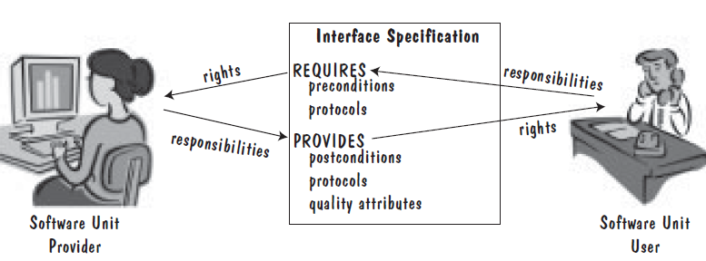
Design by Contract
Design Contract between software provider and user
Notes:
The contract covers mutual obligations (the preconditions), benefits (the postconditions), and consistency constraints (called invariants).

Slide 7
Other Design Considerations Designing User Interfaces
Must consider several issues:
identifying the humans who will interact with the system
defining scenarios for each way that the system can perform a task
designing a hierarchy of user commands
refining the sequence of user interactions with the system
designing relevant classes in the hierarchy to implement the user-interface design decisions
integrating the user-interface classes into the overall system class hierarchy

Slide 8
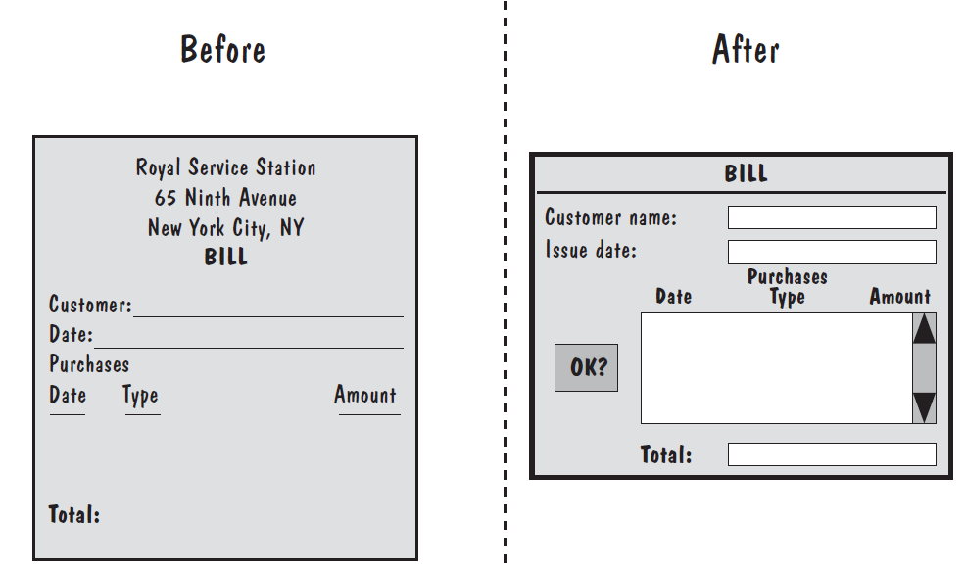
Other Design Considerations Designing User Interfaces
Notes:
We determine how paper flows in the existing system; the paper documents may suggest comfortable user interfaces in the automated system. For example, the lefthand side of Figure shows the paper bill that Manny uses at the Royal Service Station. Now, to automate his billing process, we may suggest a screen like the one on the right-hand side.

Slide 9
Component based Software Engineering
Components are higher-level abstractions than objects and are defined by their interfaces.
They are usually larger than individual objects, and all implementation details are hidden from other components.
Component-based software engineering is the process of defining, implementing, and integrating or composing these loosely coupled, independent components into systems.

Slide 10
Component based Software Engineering
Components are independent, so they do not interfere with each other’s operation.
Components communicate through well-defined interfaces.
Component infrastructures offer a range of standard services that can be used in application systems. This reduces the amount of new code that must be developed.

Slide 11
Component
A component represents a reusable piece of software that provides some meaningful aggregate of functionality.
At the lowest level, a component is a cluster of classes that are themselves cohesive but are loosely coupled relative to other clusters.
Each class in the system must live in a single component or at the top level of the system.
A component, collaborating with other components through well-defined interfaces to provide a system’s functionality, may itself be comprised of components that collaborate to provide its own functionality.
Thus, components may be used to hierarchically decompose a system and represent its logical architecture.
The essential elements of a component diagram are components, their interfaces, and their realizations.

Slide 12
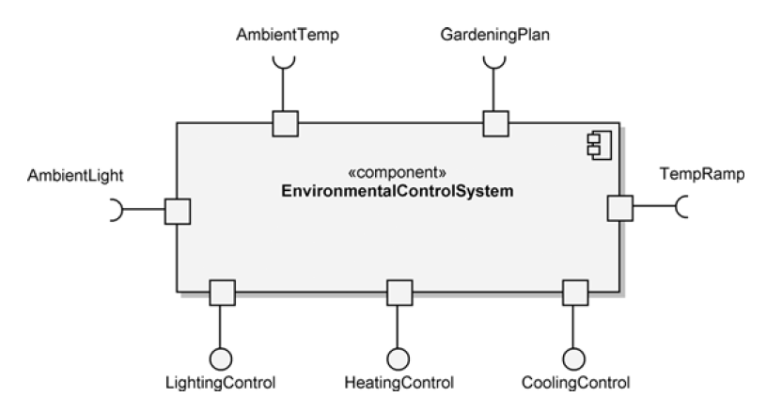
Component Notation
Its name, EnvironmentalControlSystem, is included within the classifier rectangle in bold lettering, using the specific naming convention defined by the development team.
In addition, one or both of the component tags should be included: the keyword label «component» and the component icon shown in the upper right-hand corner of the classifier rectangle.

Slide 13
Component Notation
On the boundary of the classifier rectangle, we have seven ports, which are denoted by small squares. Ports are used by the component for its interactions with its environment
Ports have public visibility unless otherwise noted.
Components may also have hidden ports, which are denoted by the same small squares, but they are represented totally inside the boundary of the composite structure, with only one edge touching its internal boundary.
Hidden ports may be used for capabilities such as test points that are not to be publicly available.

Slide 14
Component Notation
Ports have connected interfaces, which define the component’s interaction details.
The interfaces are shown in the ball-and-socket notation.
Provided interfaces use the ball notation to specify the functionality that the component will provide to its environment i.e. LightingControl.
Required interfaces use the socket notation to specify the services that the component requires from its environment i.e. AmbientTemp

Slide 15
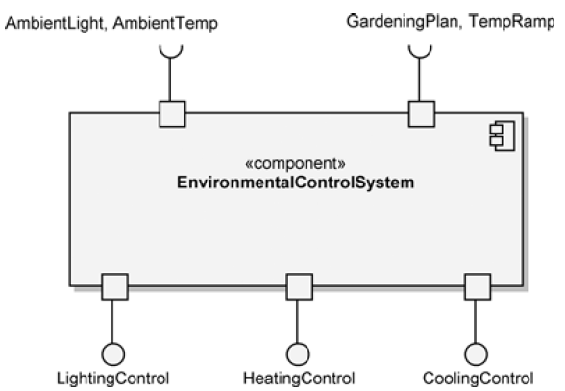
Component Notation
Representation of EnvironmentalControlSystem is considered a black-box perspective since we see only the functionality required or provided by the component at its boundary.
We are not able to peer inside and see the encapsulated components or classes that provide the functionality.
A one-to-one relationship between ports and interfaces is not required; ports can be used to group interfaces

Slide 16
Component Diagram
During development, we use component diagrams to indicate the logical layering and partitioning of our architecture.
We represent the interdependencies of components, that is, their collaborations through well-defined interfaces to provide a system’s functionality

Slide 17
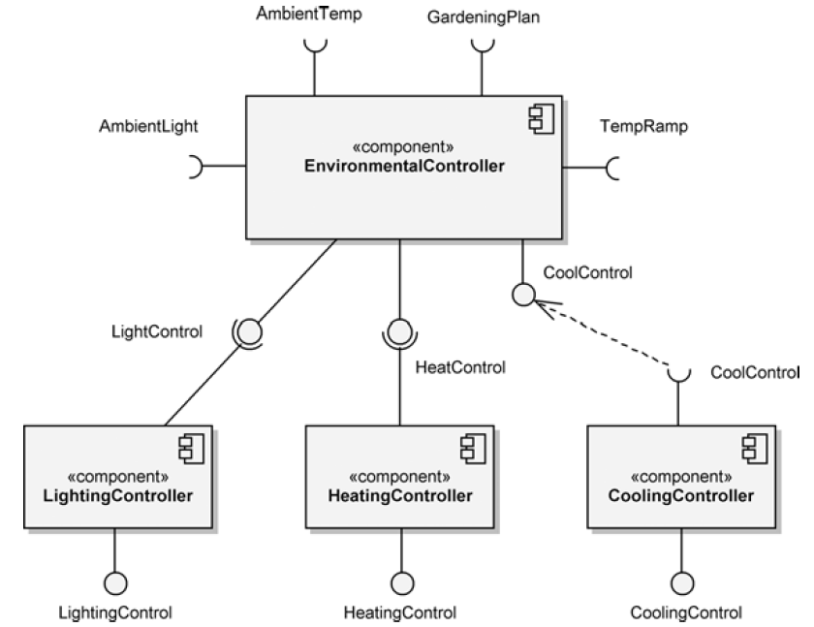
Component Diagram(EnvironmentalControlSystem)

Slide 18
Component Diagram
Ball-and-socket notation is used to specify the required and provided interfaces of each of the components.
The interfaces between the components are called assembly connectors; they are also known as interface connectors.
The interface between EnvironmentalController and CoolingController is shown with a dependency to illustrate another form of representation.
This dependency is actually redundant because the interface names are the same: CoolControl

Slide 19
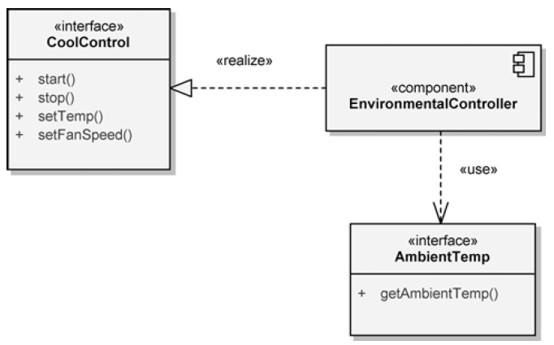
Component Diagram
If we need to show more details about a component’s interfaces, we may provide an interface specification.
EnvironmentalController realizes the CoolControl interface; this means that it provides the functionality specified by the interface.
This functionality is starting, stopping, setting the temperature, and setting the fan speed for any component using the interface. These operations may be further detailed with parameters and return types, if needed.
The CoolingController component requires the functionality of this interface.

Slide 20
Component Diagram
It also shows the dependency of the EnvironmentalController component on the AmbientTemp interface.
Through this interface, EnvironmentalController acquires the ambient temperature that it requires to fulfill its responsibilities within the EnvironmentalControlSystem component.

Slide 21
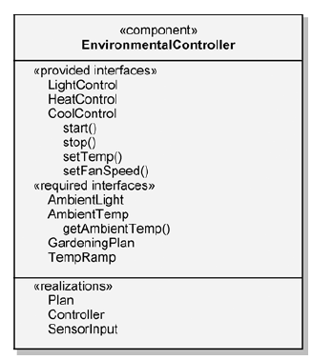
Component Diagram

Slide 22
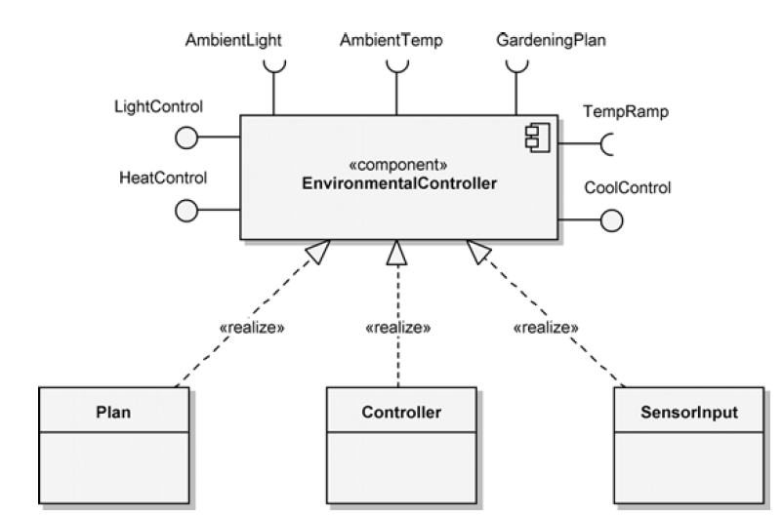
Component Realization
EnvironmentalController component is realized by the classes Plan, Controller, and SensorInput.
We need a realization dependency from each of the classes to EnvironmentalController

Slide 23
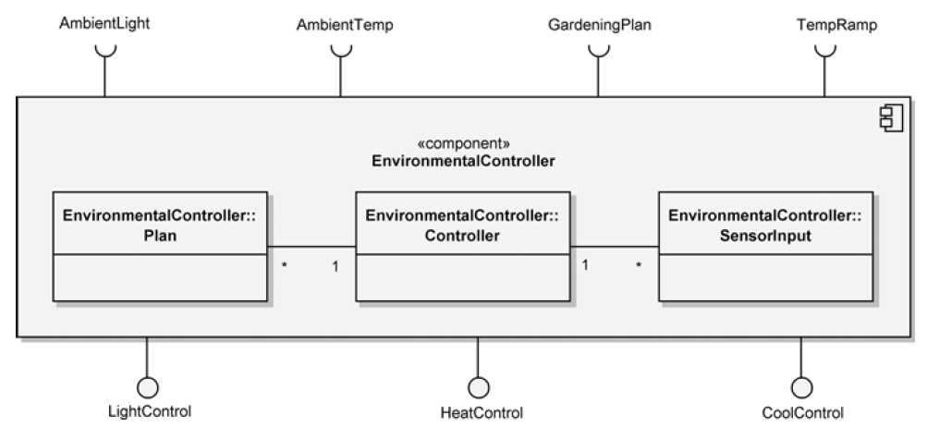
Containment Representation of EnvironmentalController’s Realization
EnvironmentalController component is realized by the classes Plan, Controller, and SensorInput.

Slide 24
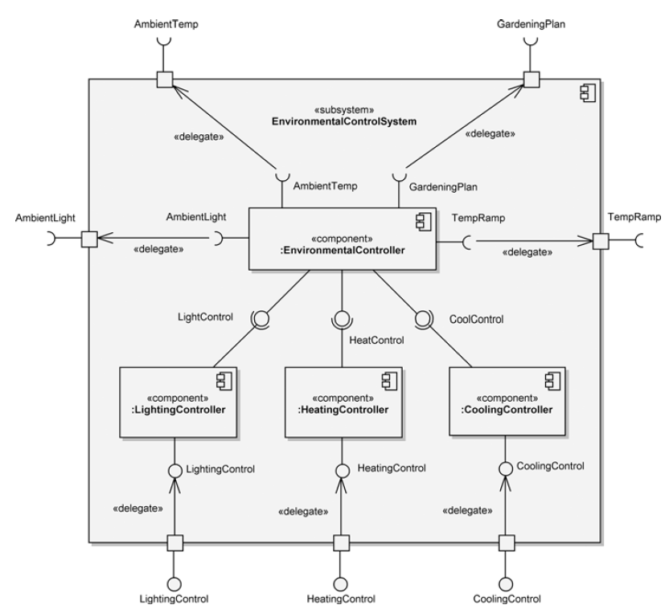
Component’s Internal Structure
Notes:
The internal structure of a component may be shown by using an internal structure diagram; Figure shows such a diagram for the EnvironmentalControlSystem subsystem. In this example, we have changed its keyword label from «component» to «subsystem» because it is comprised of four components of some complexity that are logically related.
The «delegate» label on the lines between the interfaces of the internal components and the ports on the edge of the EnvironmentalControlSystem. These connections provide the means to show which internal component fulfills the responsibility of the provided interfaces and which internal component needs the services shown in the required interfaces
:EnvironmentalController requires GardeningPlan, which specifies the environmental needs (lighting, heating, and cooling) of the Hydroponics Gardening System. The needs of this required interface are delegated to an unnamed port, to which is attached the GardeningPlan interface. In this manner, we know that we must provide the EnvironmentalControlSystem component with a gardening plan if we intend to use its services

Slide 25
Component Diagram
Subsystems partition the logical model of a system.
A subsystem is an aggregate containing other subsystems and other components.
Each component in the system must live in a single subsystem or at the top level of the system.
In practice, a large system has one top-level component diagram, consisting of the subsystems at the highest level of abstraction.

Slide 26
Decision Tracking System (DTS)
Consider a decision tracking system for recording design problems, discussions, alternative evaluations, decisions, and their implementation in terms of tasks. DesignProblem and Option represent the exploration of the design space: we formulate the system in terms of a number of DesignProblem and document each Option they explore. The Criterion class represents the qualities in which we are interested. Once we assessed the explored Options against desirable Criteria, we implement Decisions in terms of Tasks. Tasks are recursively decomposed into Subtasks small enough to be assigned to individual developers. We call atomic tasks ActionItems.

Slide 27
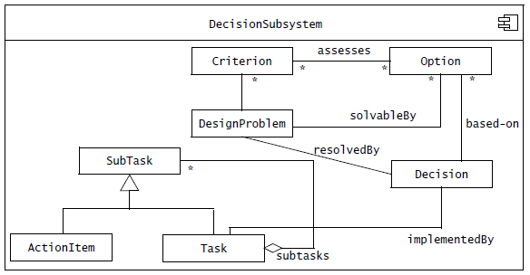
DTS Subsystem

Slide 28
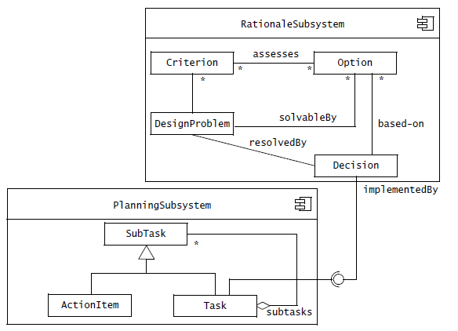
Component Diagram (Internal View)
Better Cohesion

Slide 29
References
Roger S. Pressman, Software Engineering A Practitioner’s Approach, 9th Edition. McGrawHill
Shari PFleeger, Joanne Atlee, Software Engineering: Theory and Practice, 4th Edition
Grady Booch et al., Object-Oriented Analysis and Design with Applications (3rd Edition), Pearson 2007.

